Slide 1


The process of building an APP 👩‍💻

Slide 2
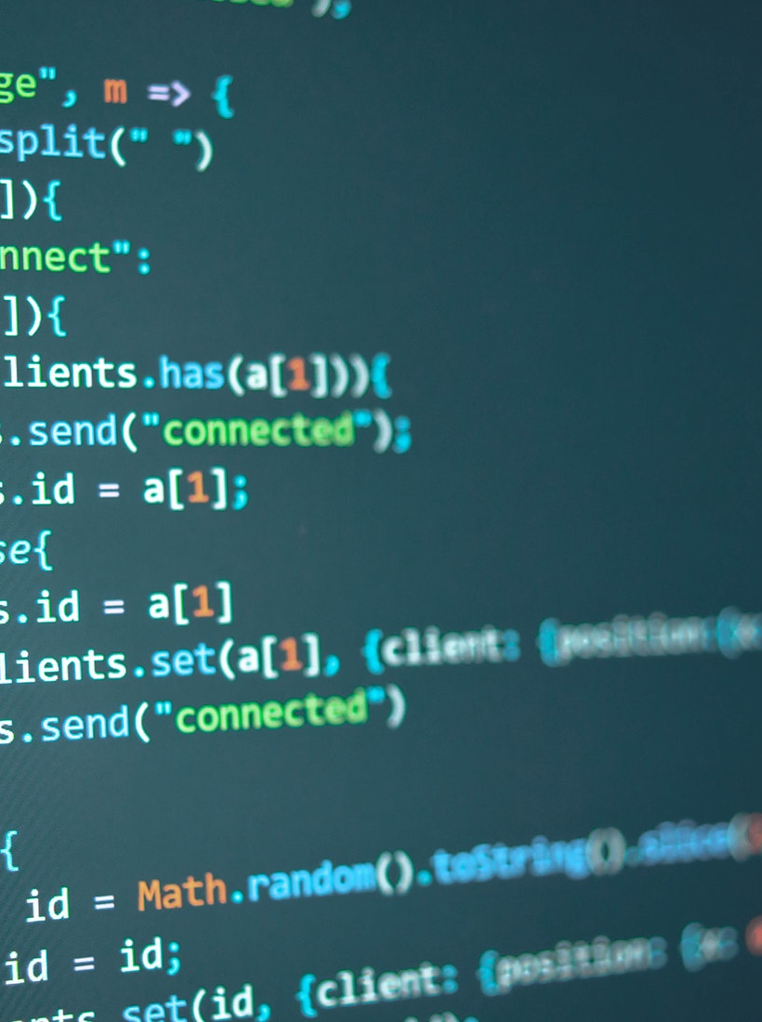
Development Order
JavaScript
Research
Plan
Concept Development (Wireframe + Design)
Prototype
Test
Finalise

Slide 3
Research

Slide 4
Research
JavaScript
Look at similar websites
Look at colour schemes
Talk with the client

Slide 5
Plan

Slide 6
Plan
JavaScript
Answer the questions
What is the site's purpose?
Who is the attended audience?
Is there a style guide?
What is the content that will be displayed?
Create Mood board

Slide 7
Concept Design

Slide 8
Wireframe
JavaScript
MovieLand
Let’s find that movie!
Search Box
Search
Image
Movie Data

Slide 9
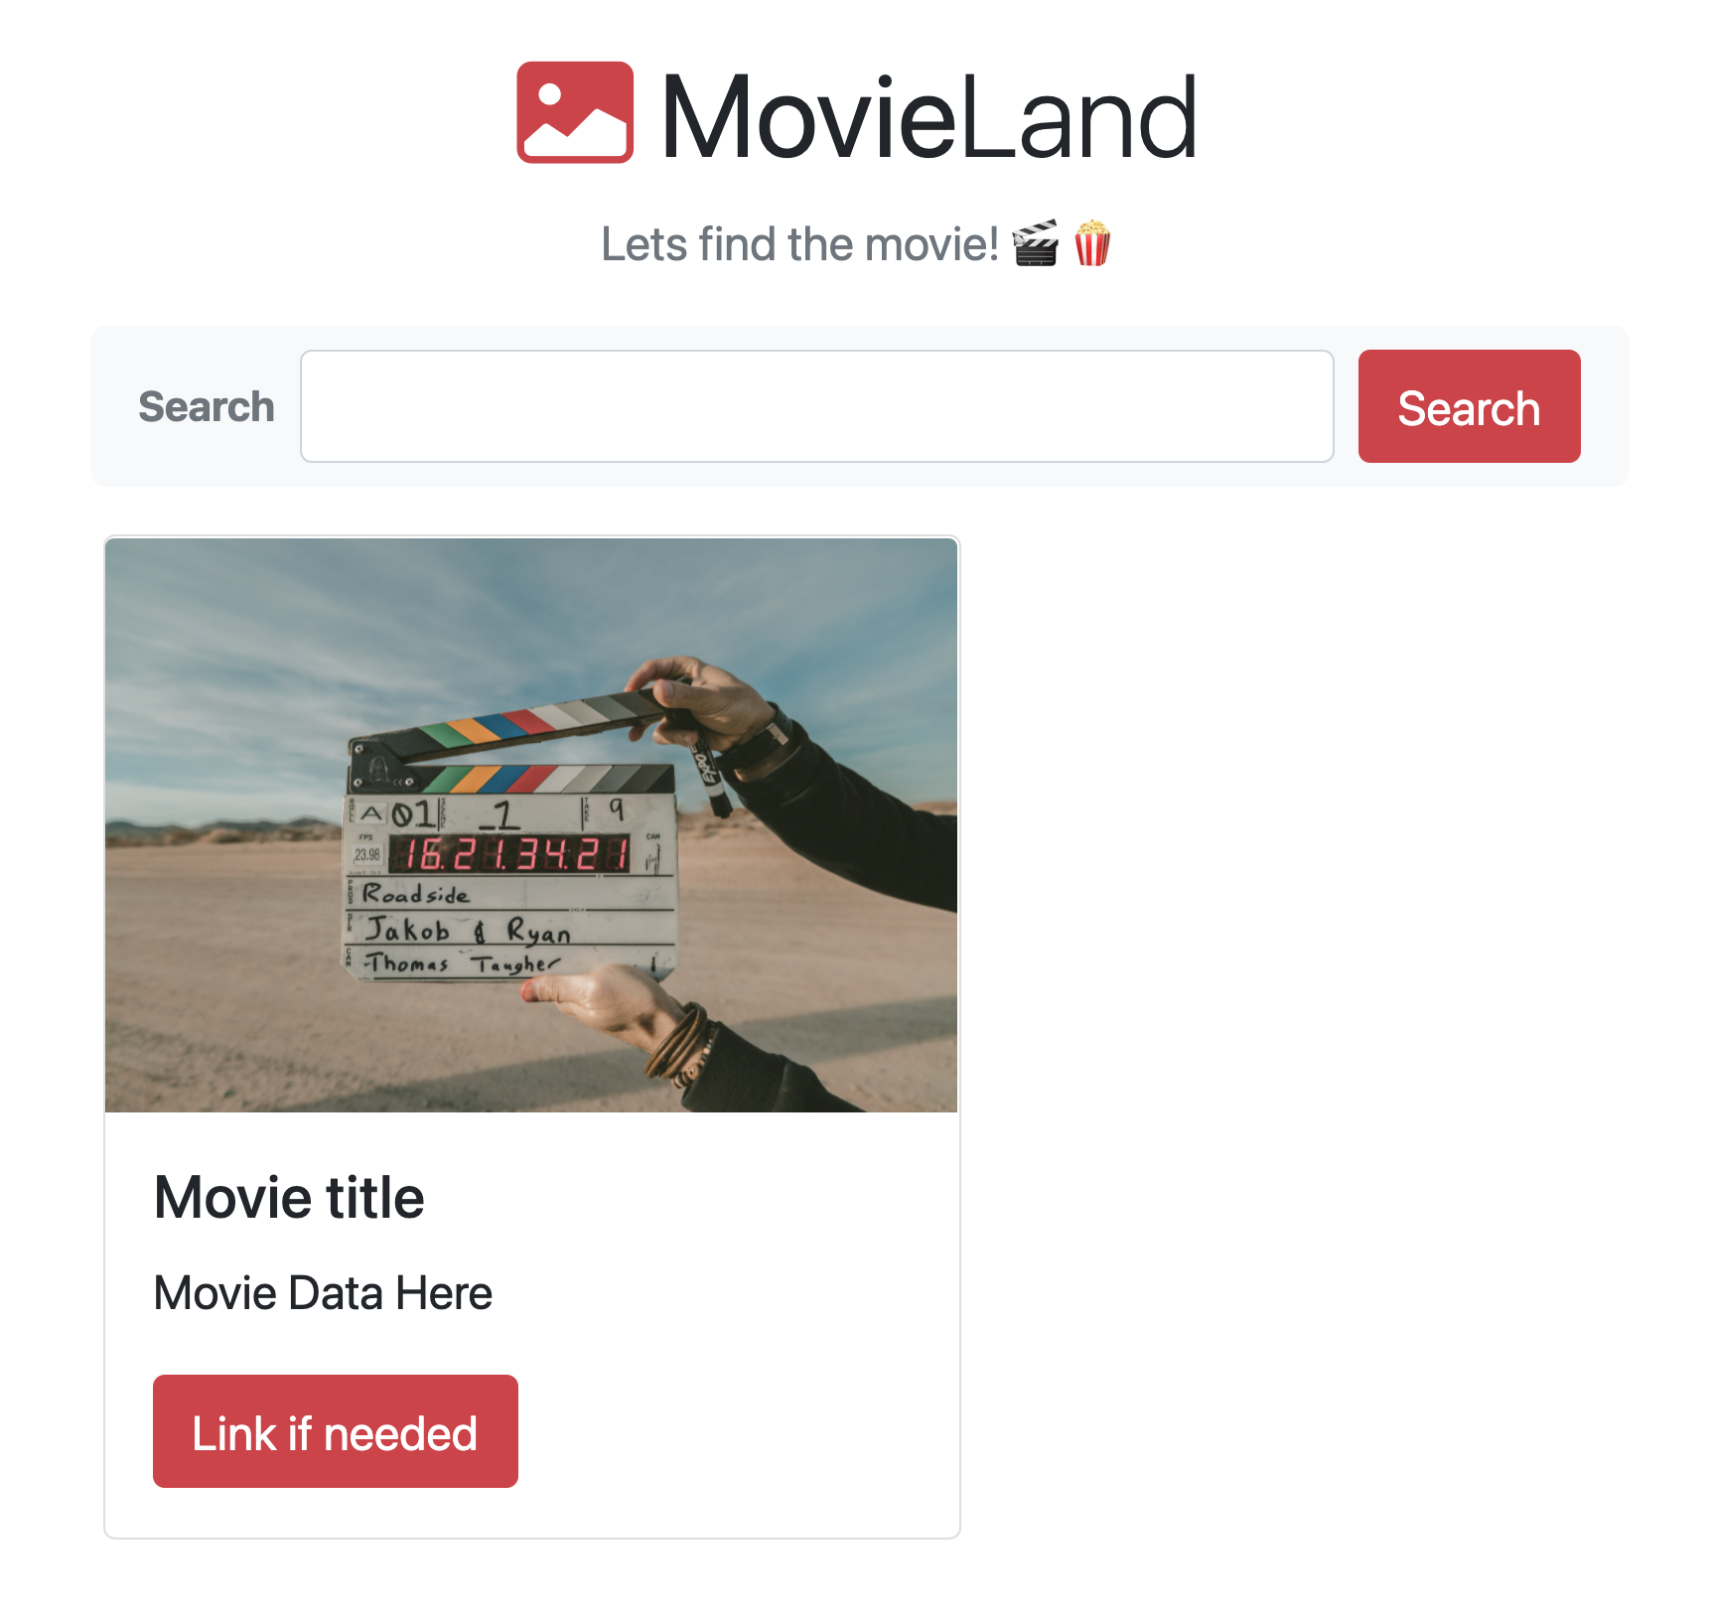
Design the Layout – Prototype the Layout
JavaScript

Slide 10
Build Your Prototype

Slide 11
Test and Finalise

